Slide 1
Lecture 1
Stress Tensor
Equilibrium

Slide 2
Body and Surface Loads Result In An Internal Force Distribution
s1
n
s2

Slide 3
Body and Surface Loads Over An Area Define Stress On A Surface
y
τ_{xy}
τ_{xz}
σ_{x}
x
z

Slide 4
Stress at a Point Shown in the Tensile (+) Direction
y
y
σ_{y}
τ_{yz}
τ_{yx}
τ_{zy}
τ_{xy}
σ_{x}
τ_{xz}
τ_{zx}
σ_{z}
σ_{z}
τ_{yx}
τ_{xz}
σ_{x}
τ_{xy}
τ_{zy}
z
x
z
τ_{yx}
τ_{yz}
x
σ_{y}
Surfaces with a Positive
Directed Area Normal
Surfaces with a Negative
Directed Area Normal

Slide 5
Stress Tensor Can Be Expressed In Multiple Ways

Slide 6
Dilatational and Distortional Stress Tensors
Dilatational Tensor
Distortional Tensor

Slide 7
EXAMPLE: Stress Tensor
At a specified point in a body, the state of stress with respect to a Cartesian coordinate system is,
Determine the Dilatation and Distortion stress tensors

Slide 8
Moment Equilibrium in an Element with Finite Dimensions (about x)
y
σ_{x}
τ_{xz}
τ_{zx}
σ_{z}
Δy
τ_{xy}
τ_{zy}
x
z
τ_{yx}
τ_{yz}
Δx
σ_{y}
Δz

Slide 9
Relationship of Shear Stress on Perpendicular Surfaces

Slide 10
Force Equilibrium in an Element with Finite Dimensions (in x)
y
σ_{x}
τ_{xz}
τ_{zx}
σ_{z}
Δy
τ_{xy}
τ_{zy}
x
z
τ_{yx}
τ_{yz}
Δx
σ_{y}
Δz

Slide 11
Elastic Equations of Equilibrium

Slide 12
The Stress Tensor Rewritten Accounting for Symmetry

Slide 13
EXAMPLE: 3D Equilibrium
The stress field within an elastic structural member is expressed as follows:
σ_{x}=-x³+y², τ_{xy}=5z+2y², τ_{xz}=xz³+x²y
σ_{y}=2x³+.5y², τ_{yz}=0, σ_{z}=4y²-z³
Determine the body force distribution required for equilibrium.

Slide 14
EXAMPLE: Equilibrium Equations
Determine whether the following two dimensional stress field is possible within an elastic structural member. Assume that the body forces are negligible

Slide 15
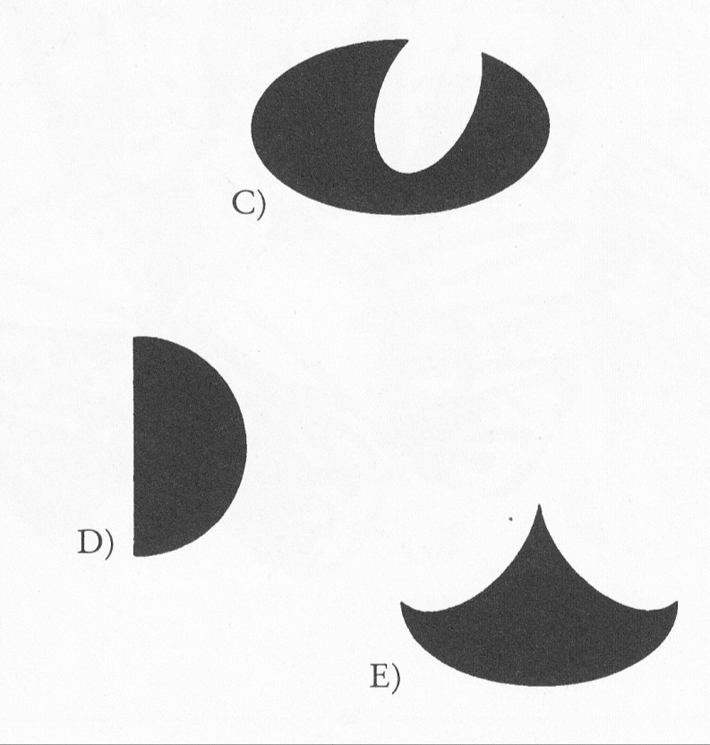
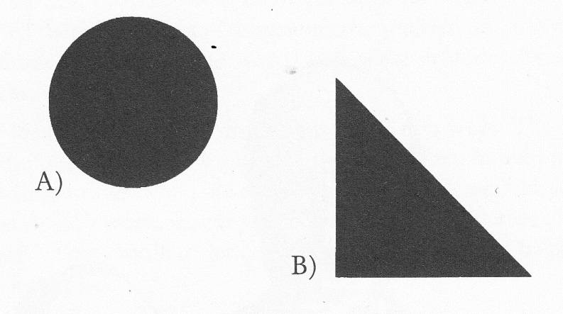
Which of these figures is not like the others?

Slide 16
LECTURE 2
Stress Transformations
Principal Stress
Mohr’s Circle For Stress

Slide 17
Stress at a Point Shown in the Tensile (+) Direction
y
y
σ_{y}
τ_{yz}
τ_{yx}
τ_{zy}
τ_{xy}
σ_{x}
τ_{xz}
τ_{zx}
σ_{z}
σ_{z}
τ_{yx}
τ_{xz}
σ_{x}
τ_{xy}
τ_{zy}
z
x
z
τ_{yx}
τ_{yz}
x
σ_{y}
Surfaces with a Positive
Directed Area Normal
Surfaces with a Negative
Directed Area Normal

Slide 18
Transforming Stress in Three Dimensions
A is the area
of the inclined
surface
y
y
θ_{x’y}
x’
A_{z}
x’
y’
y’
A_{x}
τ_{x’y’}
σ_{z}
σ_{x’}
θ_{x’x}
τ_{zx}
σ_{x}
τ_{xz}
τ_{zy}
τ_{xy}
τ_{yz}
x
x
τ_{yx}
σ_{y}
A_{y}
τ_{x’z’}
θ_{x’z}
z
z
z’
z’

Slide 19
Direction Cosines Between Coordinate Axes
A is the area
of the inclined
surface
y
θ_{x’y}
A_{z}
x’
y’
A_{x}
θ_{x’x}
x
A_{y}
θ_{x’z}
z
z’

Slide 20
Resultant Stress Found From Equilibrium Equation
y
x’
y’
τ_{x’y’}
σ_{z}
σ_{x’}
τ_{zx}
σ_{x}
τ_{xz}
τ_{zy}
τ_{xy}
τ_{yz}
x
τ_{yx}
σ_{y}
τ_{x’z’}
z
z’

Slide 21
Transformation Equations

Slide 22
Inverting the Stress Tensor
y
θ_{x’y}
A_{z}
x’
y’
A_{x}
θ_{x’x}
x
A_{y}
θ_{x’z}
z
z’

Slide 23
EXAMPLE: Transformation of Axes
Write the transformation Matrix for the following:
- First a positive 45° about z axis
- Second a positive 30° about the new x’ axis

Slide 24
SOLUTION: Transformation of Axes
Write the transformation Matrix for the following:
First a positive 45° about z axis
- Second a positive 30° about the new x’ axis

Slide 25
EXAMPLE: Stress Transformation
The stress tensor at a point in a machine element with respect to the inertial coordinate system is
Determine the state of stress if the stress element is rotated 45º counterclockwise about the z axis followed by 30° about the new x’ axis.

Slide 26
SOLUTION: Stress Transformation
Stress Transformation
Transformation Matrix
Transpose of Transformation Matrix

Slide 27
Taking Time to Think
Shown below is the Roman numeral seven. By adding only a single line, turn it into an eight
VII
This is pretty easy; all you have to do is add a vertical line to the right of the VII to create an eight: VIII. Now consider something more challenging.
Shown below is a roman numeral nine. By adding only a single line, turn it into a 6.
IX

Slide 28
LECTURE 3
Principal Stress
Mohr’s Circle For Stress

Slide 29
Stress at a Point Shown in the Tensile (+) Direction
y
y
σ_{y}
τ_{yz}
τ_{yx}
τ_{zy}
τ_{xy}
σ_{x}
τ_{xz}
τ_{zx}
σ_{z}
σ_{z}
τ_{yx}
τ_{xz}
σ_{x}
τ_{xy}
τ_{zy}
z
x
z
τ_{yx}
τ_{yz}
x
σ_{y}
Surfaces with a Positive
Directed Area Normal
Surfaces with a Negative
Directed Area Normal

Slide 30
Principal Stresses
σ₁, σ₂, σ₃
Eigenvalues of Stress Tensor
Eigenvectors are the direction cosines for the Principal Stresses

Slide 31
Three Dimensional Stress Invariants

Slide 32
EXAMPLE: Eigenvalues and Functions
Determine the principal stresses and their directions for the tensor shown.

Slide 33
SOLUTION: In MatLab Eigenvalues and Functions
>> S=[50 10 0 ; 10 20 40; 0 40 30]
S =
50 10 0
10 20 40
0 40 30
>> [DCS,PS]=eig(S)
DCS =
-0.1135 0.9263 0.3592
0.7509 -0.1568 0.6415
-0.6506 -0.3425 0.6778
PS =
-16.1676 0 0
0 48.3076 0
0 0 67.8600

Slide 34
SOLUTION: Eigenvalues and Functions
Principal Stress
Direction Cosines

Slide 35
Three Dimensional Mohr’s Circle
y
σ_{y}
τ_{yx}
σ_{x}
σ_{z}
σ_{z}
τ_{xy}
τ_{xy}
τ_{zy}
σ_{x}
z
x
τ_{yx}
σ_{y}
σ
y
σ_{y}
τ_{xy}
σ_{x}
σ_{x}
x
σ_{z} is present
but not shown
τ_{xy}
τ_{ccw}
σ_{y}

Slide 36
EXAMPLE: 3D Mohr’s Circle
A structural member is found to have an axial stress of 150MPa and a transverse stress of 100MPa. The stress orthogonal to these stresses is zero. Calculate the maximum shear stress in this member at this point.

Slide 37
EXAMPLE: 3D Mohr’s Circle
Determine the principal stresses and the maximum shear stress for the following state of stress.

Slide 38
Recharge
Connect all nine dots with four straight lines without lifting your pen/pencil.

Slide 39
LECTURE 4
Strain – Displacement Relations

Slide 40
Strain-Displacement Relationships, ε and γ
C’
B’
D’
Q’
B
C
Q
D

Slide 41
Normal Strain - Displacements

Slide 42
Shear Strain - Displacements

Slide 43
Strain-Displacement Relationships, Θ
C’
B’
D’
Q’
B
C
Q
D

Slide 44
Curvature - Displacements

Slide 45
Example
The following displacement field is applied to a certain body where k=10^{-4.}
u=k(2x+y²), v=k(x² -3y²), w=0
(a) Show the distorted configuration of a two-dimensional element with sides dx and dy and its lower left corner (point A) initially at the point (2,1,0), i.e., determine the new length and angular position of each side.

Slide 46
Compatibility: 6 Strain Equations in 3 Displacements

Slide 47
Compatibility: Repeating For Other Strain Combinations

Slide 48
Compatibility Continued

Slide 49
Strain Tensor

Slide 50
Strain Transformations

Slide 51
Two Dimensional/Plane Strain Transformations
General Transformation Equations
Principal Strains

Slide 52

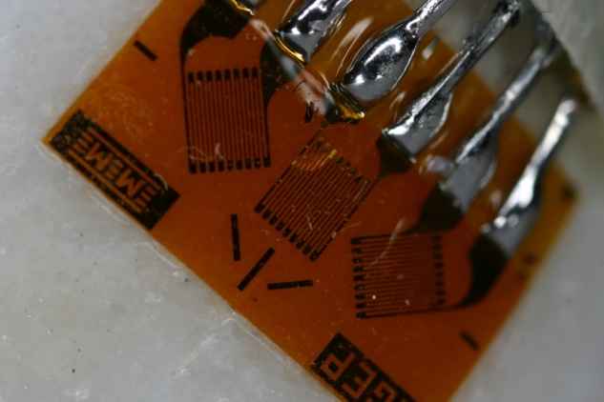
Typical Strain Gage Rosettes
45°
c
45°
b
a

Slide 53
Typical Strain Gage Rosettes
axial
hoop
a
45°
c
b
45°
|ε_{a*}|= ε_{a} = 1237(10⁻⁶) in/in = 1237με (12)
|ε_{b*}|= ε_{b} = 1270(10⁻⁶) in/in = 1270με (13)
|ε_{c*}|= ε_{c} = 402(10⁻⁶) in/in = 402με (14)

Slide 54
Transverse Sensitivity
(1)
(2)
(3)

Slide 55
Mohr’s Circle for Strain
ε_{c2}
ε_{a1}
45°
ε_{b2}
ε_{p2}
ε_{p1}
a
45°
b
ε_{b1}
ε_{c1}
ε_{a2}
ε_{c}
c
|ε_{a}-ε_{c}|
ε_{a}
ε_{b}
|ε_{a*}|= ε_{a} = 1237(10⁻⁶) in/in = 1237με
|ε_{b*}|= ε_{b} = 1270(10⁻⁶) in/in = 1270με
|ε_{c*}|= ε_{c} = 402(10⁻⁶) in/in = 402με

Slide 56
Mohr’s Circle for Strain
2|ε_{ave}-ε_{b}|=|ε_{a}+ε_{c}-2ε_{b}|
ε_{ave}=½(ε_{a}+ε_{c})
|ε_{ave}-ε_{b}|
ε_{c2}
ε_{a1}
45°
ε*
ε_{b2}
2⋅φ
ε_{p2}
ε_{p1}
h₂
h₁
a
45°
b
2⋅φ
ε_{b1}
ε_{c1}
ε_{a2}
ε_{c}
c
|ε_{a}-ε_{c}|
ε_{a}
ε_{b}
|ε_{a*}|= ε_{a} = 1237(10⁻⁶) in/in = 1237με
|ε_{b*}|= ε_{b} = 1270(10⁻⁶) in/in = 1270με
|ε_{c*}|= ε_{c} = 402(10⁻⁶) in/in = 402με

Slide 57
Time-Out
An eccentric old king wants to give his throne to one of his two sons. He decides that a horse race will run and the son who owns the slower horse will become king. The sons, each fearing that the other will cheat by having his horse run less fast than it is capable, ask the court fool for his advice. With only two words the fool tells them how to make sure that the race will be fair. What are the two words?

Slide 58
LECTURE 5
Stress-Strain Relations

Slide 59
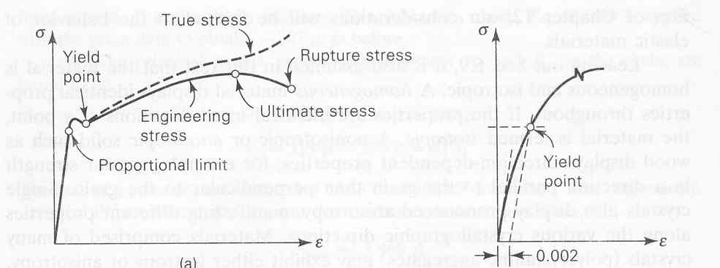
Stress-Strain Curve True Stress-Strain versus Engineering Stress-Strain

Slide 60
Relationship Between Stress and Strain
y
σ_{y}
y
y
σ_{x}
σ_{z}
z
x
σ_{x}
σ_{z}
z
x
x
σ_{y}
z

Slide 61
Stress-Strain Relations

Slide 62
Matrix Form of Stress-Strain Relations

Slide 63
Matrix Form of Stress-Strain Relations

Slide 64
Strain-Stress Relations

Slide 65
Alternate Form of the Strain-Stress Relations

Slide 66
EXAMPLE: Compatibility
For the beam shown, determine the displacement field due to BENDING ONLY. Consider the cross section of the beam to be rectangular and thin so that deflections are not functions of z.
y
L
x

Slide 67
SOLUTION: Basic Mechanics
Given the Bending Moment in the Beam
The Stress Field from Strength of Materials
Strains can not be computed using Hooke’s Law

Slide 68
SOLUTION: Strain-Displacement Equations
Strain-Displacement Relationships

Slide 69
SOLUTION: Shear Strain-Displacement
Shear Strain-Displacement Relationships
Given the shear stress is zero

Slide 70
SOLUTION: Integrating the Result
Substituting the Result into the Displacement Expressions

Slide 71
Anisotropic Materials
ISOTROPIC - material properties are the same in all directions
ANISOTROPIC - material properties change with direction
HOMOGENEOUS - material of uniform composition throughout and whose properties are constant at every point
HETEROGENEOUS - material uniformity within a body consisting of dissimilar constituents separately identifiable

Slide 72
Stress-Strain Relations
Stiffness
Compliance

Slide 73
Symmetry of the Stiffness Matrix
Elastic Potential/Strain Energy Density
Incremental work per unit volune
dW=σ_{i}dε_{i}
Using the Stress-Strain Relations
dW=C_{ij}ε_{j}dε_{j}
Work per Unit Volume
W=1/2 C_{ij}ε_{i}ε_{j}
dW/dε_{i}=C_{ij}ε_{j} or dW²/dε_{i} dε_{j} =C_{ij} thus C_{ij}= C_{ji}

Slide 74
Stiffness and Compliance down from 36 to 21 Constants
Stiffness
Compliance

Slide 75
One Plane of Elastic Symmetry
Monoclinic
13 Independent Constants

Slide 76
Three Planes of Elastic Symmetry
Orthotropic Body
9 Independent Constants

Slide 77
Relationship Between S and C

Slide 78
One Plane in which the Mechanical Properties are Equal
Transversely Isotropic
6 Independent Constants

Slide 79
Material Properties Equal in all Directions
Isotropic
2 Independent Constants

Slide 80
Matrix Form of Stress-Strain Relations

Slide 81
Matrix Form of Stress-Strain Relations

Slide 82
Example 1
Given the following state of stress, determine the state of strain. E=200Gpa, υ=0.3

Slide 83
Example 2
Given the following state of strain, determine the state of stress. E=200GPa, υ=0.3

